Slide 1
CRM APPLICATION THAT HELPS TO BOOK A VISA SLOT

Slide 2
INTRODUCTION
Overview
A Visa slot management project is a system that used to track and manage the availability of visa slot, which are appoints that are required for certain visa applications. It might be used by a government agency or a visa processing centre to schedule and manage appointment with applications.

Slide 3
Purpose:
Saving the time of the customers who want to book if by using CRM application of booking a visa slot. Wandering for booking the visa slot and tracking can be reduce here. Reduce the paper filling as much the customers expecting. Ensuring the safety of the customer and parts of many verification.

Slide 4
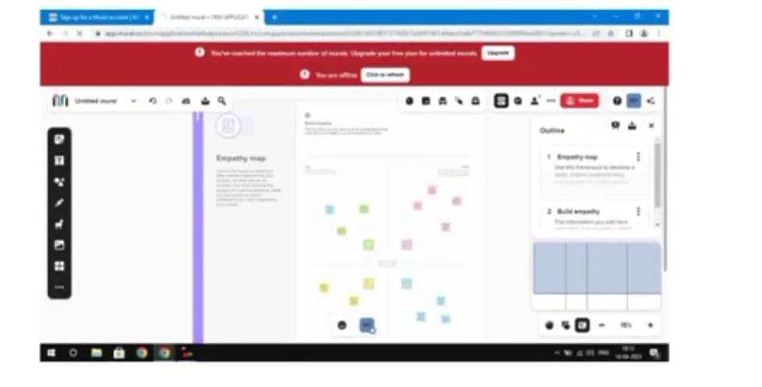
Problem definition and design thinking:
Reduce the paper costing and fulfil the customer expectation. Ensuring the safety of the customers and parties of many verification.

Slide 5
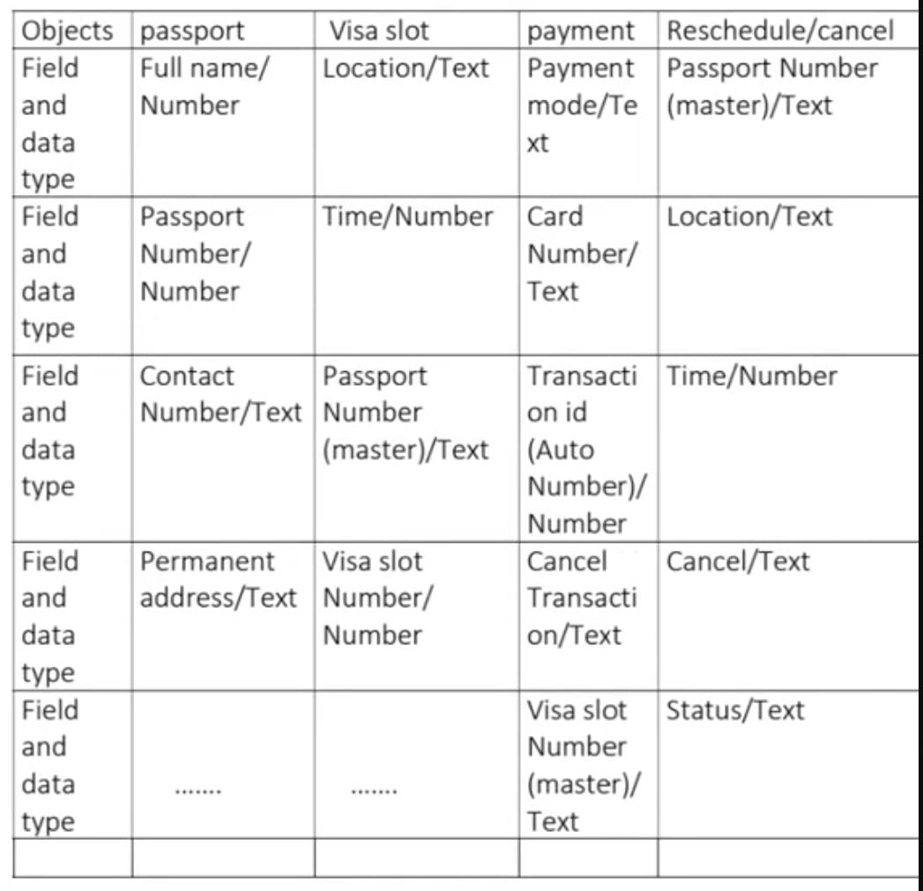
.

Slide 6
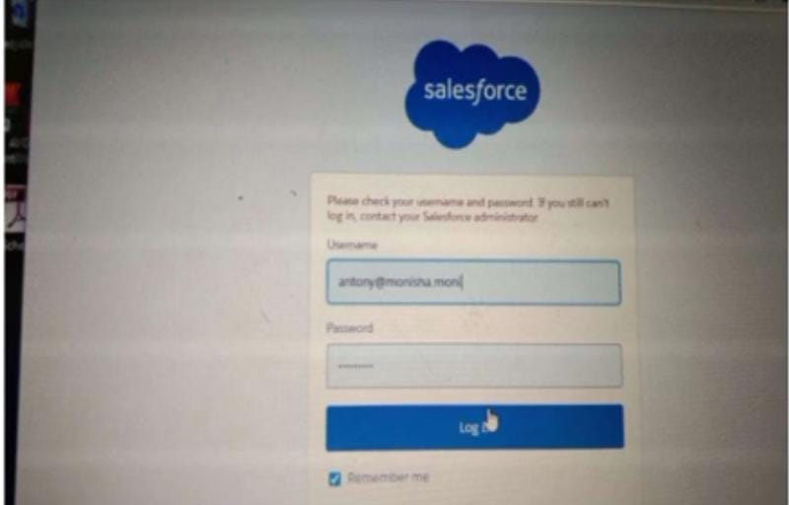
VISA SLOTACTIVITY AND SCREENSHOTS:
1.Creation of salesforce platform:
Go to Developer, salesfprce.com and click on sign up. Enter our details as Name, Email, Role, Company etc. emails is send your mail id.Go to the inbox of the email that you used while signing up. Click on the verify account to activate your account.

Slide 7
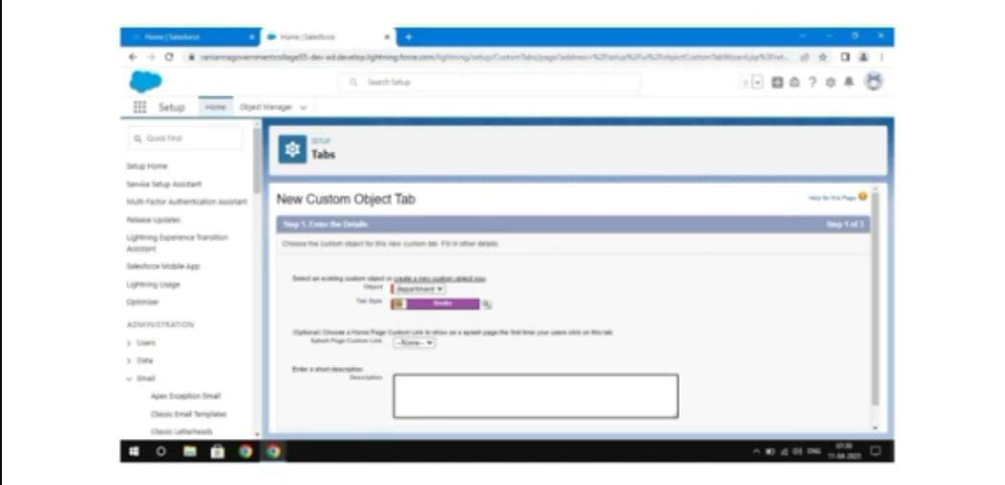
2. Creation of custom object:
Passport Navigate to setup to select the object manager and create the object gives the detail like Label name has Passport and enter the plural name, record name data type etc., and save it.

Slide 8
Create of field on custom object:
Passport:Select our object from the selection has passport and select option field and Relationship. Select our data ype as number go to the next page enter the field label has contact number and length should be 10 and you can find options like required, unique, external id select required option so that always require a value in this field in order to save. Go to next page on visible checkbox so that it as visible to all profile and select option and save it. The passport field are create like this type.

Slide 9
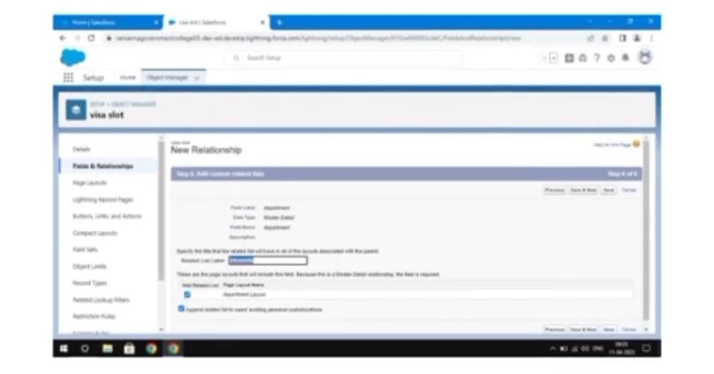
3. Creation of Relationship: Relation between the objects
To create a Mater Detail relationship between passport and visa. Select the object manager visa slot object form the list and select the field and relationship and click now. The data type has Mater detail relationship and go to the next page and save it. To create the relation ship between the between payment and visa slot in this type

Slide 10
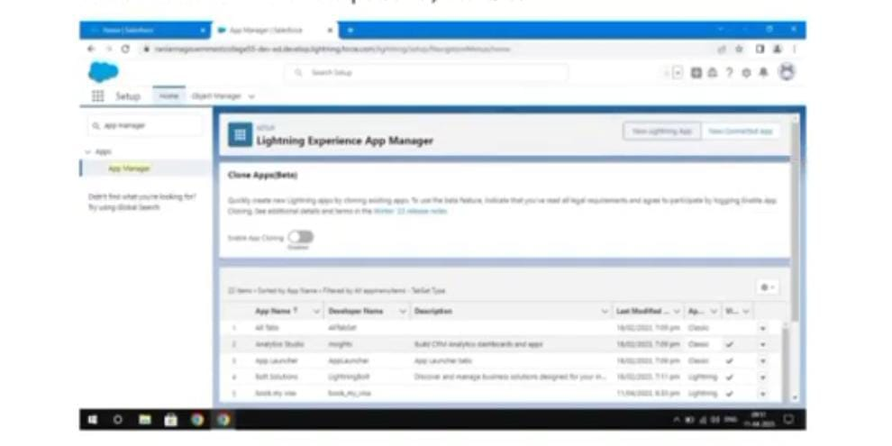
4. Creation of app:
Navigate to setup and search for app manager. To select the new lighting app option and give the app name has book my visa and upload the picture. Click next. Choose the navigation style click the next page move the objects from available items to selected items. And select the admin profile, save it.

Slide 11
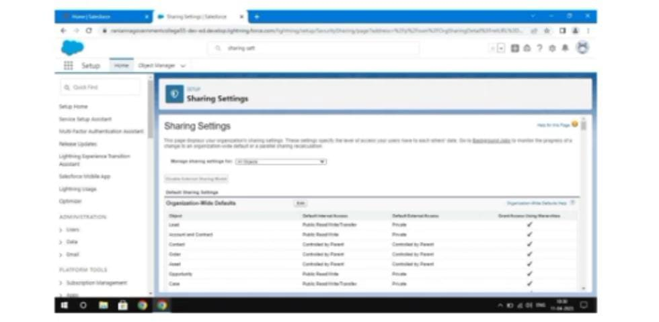
5. Creation of user:
Navigate to set up In quick find search bar, search in user and select it. Give the first name and last name. Enter your email and enter your user name. Select your user license of salesforce. The profile field is standard user. At bottom of the page check the box to generate a new password and save the page.

Slide 12
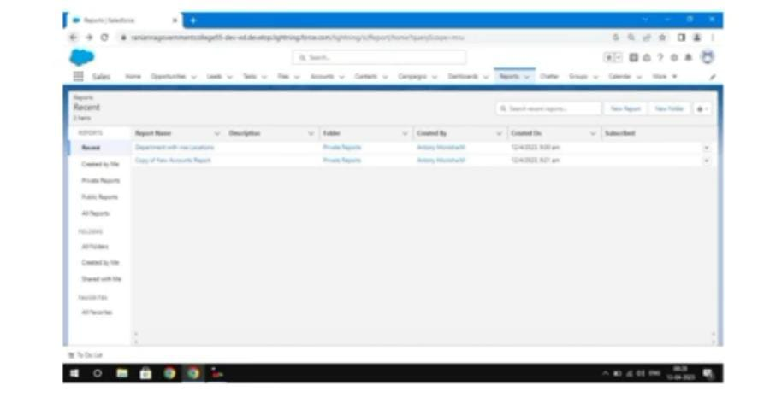
6. Create a Report
Click the app launcher and search for Book a visa. Select the report and click new report select the report type ad passport with visa slot with payment and select start report. Left side of the report you can find the outline pane. In the group row location and group column select passport: passport number to display and add the column select has visa slot..

Slide 13
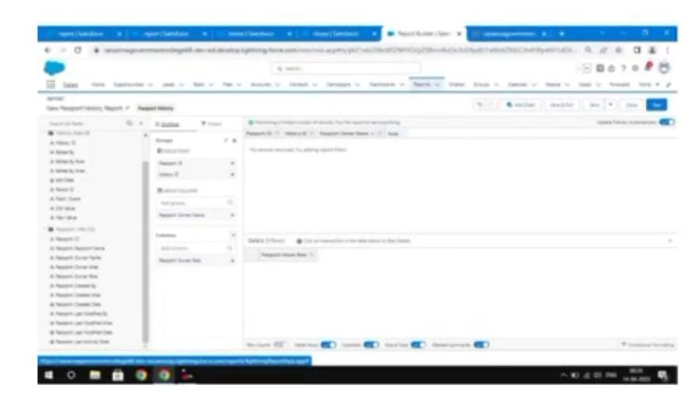
Edit the filters as show me the select all passport and passport created date select all time finally save and run it. Go to the edit option export select excel sheet format and click export. We can see the detail in the excel sheet as shown.

Slide 14
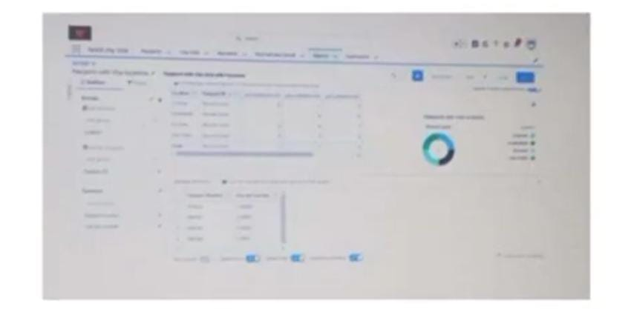
7. Create a Dashboard:
Go to the app launcher and search for book a visa. Select the dashboard and click new dashboard. Click add component and report passport with locations.Select the donut chart as selection. Ensure the value is record donut and sliced by locations. Click add and save the dashboard.

Slide 15
TRAILHEAD PROFILE PUBLIC URL:
Team leader: MOHAMMAD PEER MOHIDDIN
Team member: 1

Slide 16
Advantages:
1. Processing is fast.
2. Saving time.
3. No wandering.
4. Not much paper work.
5. Easiest way

Slide 17
Disadvantages:
1. Internet connection problem is there.
2. Poor connection leads to trouble and anxiety.
3. Poor connection.
4. Lack of leadership.
5. Burdensome data entry.
6. Can be costly

Slide 18
Applications:
This will help you to track and manage the availability of visa slot, which are appointments that are required for certain visa applications.CRM is a well conceived business strategy with long terms outcomes that maximize profitability, revenue and customer satisfaction by organising around customer segment, fostering customer satisfying actions and implementing customer centric process.CRM is a strategy employed to learn and understand customer' need wants ad behaviour in order to develop stronger and sustained relationship with them.

Slide 19
CONCLUSION:
By using the CRM application, we should track and manage the availability of visa slots easily. Booking of visa slots will be in an easier way.It is a benefical and useful one for the customers. Save the time and often visiting trouble is not there.

Slide 20
THANK YOU

